Slide 1
Software-defined Networking (SDN)
Slides from Anja Feldmann and Bala Chandrasekaran

Slide 2
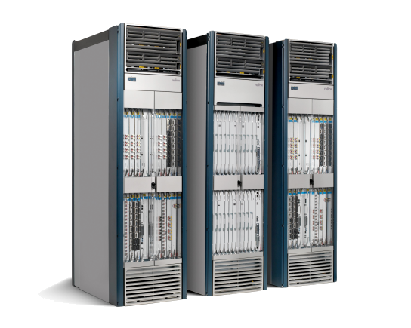
The Networking Industry (2007)
Routing, management, mobility management, access control, VPNs, …
App
App
App
Million of lines of source code
Specified by 5400 RFCs
Operating
System
Specialized Packet Forwarding Hardware
500M gates
10Gbytes RAM
Power Hungry
Many complex functions baked into the infrastructure
OSPF, BGP, multicast, differentiated services, Traffic Engineering, NAT, firewalls, MPLS, redundant layers, …
An industry with a “mainframe-mentality”
Notes:
2

Slide 3


Disadvantages of the Monolithic Approach
Closed equipment
Software bundled with hardware
Vendor-specific interfaces
Over specified : Slow protocol standardization
Few people can innovate
Equipment vendors write the code
Long delays to introduce new features
Operating a network is expensive
More than half the cost of a network
Yet, operator error causes most outages
Buggy software in the equipment
Routers with 20+ million lines of code
Cascading failures, vulnerabilities, etc.
Notes:
3

Slide 4
Traditional Networks: Data Plane
Responsible for forwarding packets
Packet streaming
Fast but stupid
Forward, filter, buffer, mark,
rate-limit, and measure packets
Notes:
Maybe this is a better picture… though need some details of what happens in each plane… like in next slides… or, have both?

Slide 5
Traditional Networks: Control Plane
Responsible for building routing tables
Distributed algorithms
(e.g., OSPF, BGP)
Slow but smart
Track topology changes, compute routes, install forwarding rules
Notes:
Maybe this is a better picture… though need some details of what happens in each plane… like in next slides… or, have both?

Slide 6
Traditional Networks: Management Plane
Management plane:
Human time scale
Slow but Really Smart
Collect measurements and configure the equipment
Notes:
Maybe this is a better picture… though need some details of what happens in each plane… like in next slides… or, have both?

Slide 7
Software Defined Networking (SDN)
Logically-centralized controller
Slow but Smart
API to the data plane
(e.g., OpenFlow)
Fast but
Dumb
Switches

Slide 8
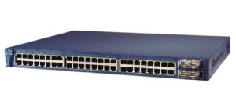
Why? A look at network elements
Control software
(spanning tree protocol,
VLAN trunking protocol, etc. )
Classical Switch:
Cisco 3548XL
Control Hardware:
Embedded PC
Dataplane:
Interfaces, TCAM, Switch fabric
A closed box

Slide 9
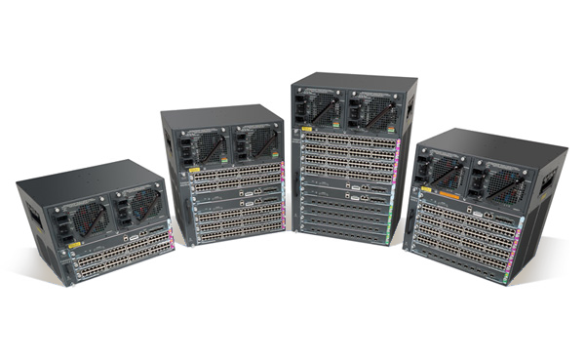
Why? A look at network elements?
Operator says:
Cisco's answer:
Buy one of these!
But I need a 3rd SPAN port!

Slide 10
Why? A look at network elements
On a more serious note
Closed HW/SW stack hurts innovation
Researchers can't try ideas at scale
Data center operators can't differentiate by building customized networks
Solution?
Open HW/SW interfaces
Build a Network Operating System

Slide 11
Software-defined networking (SDN)?
Simple and elegant idea:
Decoupling of control and data planes
Provide an open standard API

Slide 12
SDN stack
Separated into data, control, and management planes

Slide 13
Timescales
 | Data | Control | Management
Time-scale
Tasks
Location

Slide 14
Timescales
 | Data | Control | Management
Time-scale | Packet (ns) | Event (10 ms to 1 s) | Human (min. to hours)
Tasks
Location

Slide 15
Timescales
 | Data | Control | Management
Time-scale | Packet (ns) | Event (10 ms to 1 s) | Human (min. to hours)
Tasks | Forwarding, buffering, filtering, scheduling | Routing, circuit set-up | Analysis, configuration
Location

Slide 16
Timescales
 | Data | Control | Management
Time-scale | Packet (ns) | Event (10 ms to 1 s) | Human (min. to hours)
Tasks | Forwarding, buffering, filtering, scheduling | Routing, circuit set-up | Analysis, configuration
Location | Line-card hardware | Router software | Humans or scripts

Slide 17
OpenFlow
SDN standard managed by the Open Network Foundation
Version 1.1 released in 2011
Supported by major switch vendors
Canonical example of SDN, but not widely used now
Scalability problems

Slide 18
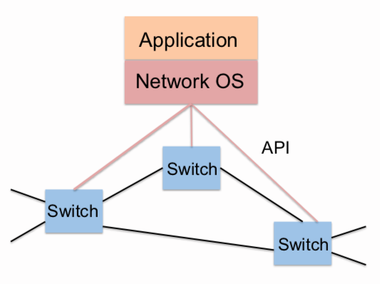
Controller: Network OS
[http://www.cs.princeton.edu/courses/archive/fall13/cos597E/docs/03API.pdf]

Slide 19
Controller: Network OS
The controller or the application can generate the command.
Command
Here’s what you do …
Event
Something happened …
[http://www.cs.princeton.edu/courses/archive/fall13/cos597E/docs/03API.pdf]

Slide 20
Controller: Network OS
OpenFlow v1.0
Command
OFPacketOut
Event
Inbound packet
OFPacketIn
Flow Table
src. MAC
dst. MAC
src. IP
dst. IP
src. port
dst. port
action
Inbound packet
Inbound packet
Inbound packet
…
…
…
…
…
…
…
…
…
…
…
…
…
…
[http://www.cs.princeton.edu/courses/archive/fall13/cos597E/docs/03API.pdf]

Slide 21
Bootstrapping
How does a switch communicate with the controller?
OpenFlow uses TCP and (preferably) TLS
Assumes existing IP connectivity

Slide 22
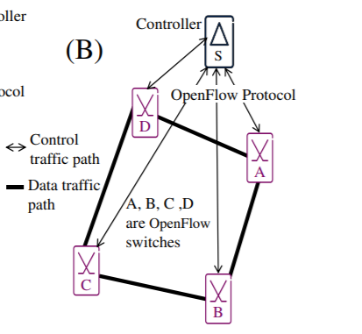
Out-of-band Mode
Figure from``Automatic bootstrapping of OpenFlow networks,” S. Sharma, D. Staessens, D. Colle, M. Pickavet and P. Demeester, 19th IEEE Workshop on Local & Metropolitan Area Networks, 2013.
Switches connect to controller using separate control network, e.g., Ethernet broadcast domain.

Slide 23
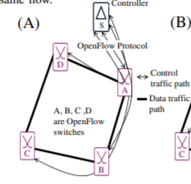
In-Band Mode
Figure from``Automatic bootstrapping of OpenFlow networks,” S. Sharma, D. Staessens, D. Colle, M. Pickavet and P. Demeester, 19th IEEE Workshop on Local & Metropolitan Area Networks, 2013.
Switches use same network to send control messages and data messages.
A switch must recognize control traffic
Forwarding of control messages must override flows set up by the controller.
Could preconfigure VLAN or MPLS, or use a more complicated bootstrapping process.

Slide 24
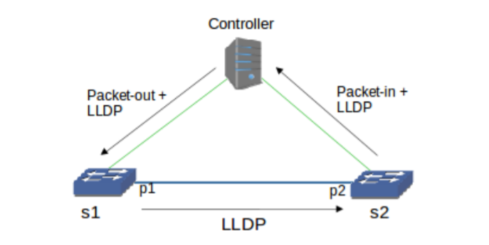
Topology Discovery
OpenFlow Discover Protocol (OFDP)
Controller sends link-layer discovery protocol (LLDP) messages to switches at fixed intervals (e.g., 10s)
Switches respond by returning LLDP messages to controller
Figure from ``Limitations of OpenFlow Topology Discovery Protocol,’’ A Azzouni, N. T. M. Trang , R. Boutaba , and G. Pujolle, 16th Annual Mediterranean Ad Hoc Networking Workshop, 2017.

Slide 25
Controller: Events
OFPacketIn
When first packet of a flow (with no matching rule in the flow table) arrives at an OF switch
Attributes: Details to help the controller/application decide
Switch ID, incoming port, headers, …

Slide 26
Controller: Output/Command
OFPacketOut
Instruction for the switch on what to do with the packet
What to do? Forward, Drop
Attributes: Details to help the switch carry out the action
Action, buffer ID, …

Slide 27
Controller: Application example
OFPacketIn
Switch ID: A, incoming port: 1, headers, …
OFPacketOut
Switch ID: A, outgoing port: *, headers, …
Application?
Hub

Slide 28
SDNApplication: It can’t be that simple …
Well, here’s an example implementation
# Create packet out message
msg = of.ofp_packet_out()
# Use the incoming packet as the data for the packet out
msg.buffer_id = event.ofp.buffer_id
# Set the in_port so that the switch knows
msg.in_port = packet_in.in_port
# Add an action to send to the specified port
msg.match = of.ofp_match.from_packet(packet)
action = of.ofp_action_output(port = of.OFPP_FLOOD)
msg.actions.append(action)
# Send message to switch
self.connection.send(msg)

Slide 29
Controller: Flow rules
Flow rules
Rather than react to every packet from the switch, can install a rule that matches on certain packet headers
Flow rules are installed by the controller and maintained in the flow table
Flow rules are generated by applications (either bundled with the controller or running on top of the controller)

Slide 30
Controller: More commands
OFFlowAdd
Add a new rule that matches on certain headers (or attributes)
e.g., all packets from src IP 1.2.3.4 and destined for 4.3.2.1 (regardless of other attributes) should be dropped (Think firewall!)
OFFlowMod
Modify an existing rule in the switch
e.g., Change the above rule to not drop such packets
OFStatisticsRequest
Instructs Switch to reply with an OFStatisticsResponse containing some statistics on traffic received by this switch
How? Switches also have counters/meters to gather metrics!

Slide 31
Controller: More events
OFFlowRemoved
Tells a controller that a flow rule was removed
Flow rules can have (hard/soft) timeouts!
OFStatisticsResponse
Statistics on traffic observed by the switch (could be useful for traffic engineering)

Slide 32
SDN Controller: Event-driven paradigm
Switch generates events and sends them to controller
Application(s) responds to the events
Controller has (or interacts with) one or more applications
Application subscribes to (a subset of) events
When application receives an event, it responds with an output (command)
Controller sends this command to the switch

Slide 33
SDN Controllers
Many exist!
NOX (C++)
POX (Python)
Floodlight (Java)
OpenDaylight (Java)
Onix
ONOS
Pyretic
Different Implementations offer different services, applications, benefits, …

Slide 34
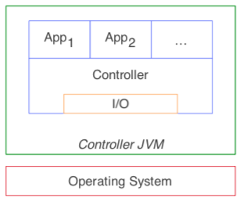
SDN Controllers: Applications
Controllers may come bundled with one or more applications
Floodlight, for instance, comes bundled with Hub, Switch, …
We can also deploy custom applications with the controller …
A traffic engineering application that performs “smart” routing by gathering details about traffic conditions in the network (through OFStatisticsRequest)
No need to reinvent the wheel
There are SDN AppStores

Slide 35
SDN Applications
Different applications can install rules that perform different actions for different matches
Flow Table
src. MAC
dst. MAC
src. IP
dst. IP
src. port
dst. port
action
…
…
…
…
…
…
…
…
…
…
…
…
…
…

Slide 36
SDN Applications
Different applications can install rules that perform different actions for different matches
Flow Table
src. MAC
dst. MAC
src. IP
dst. IP
src. port
dst. port
action
*
H
…
…
…
…
port 8
Switching
…
…
X
Y
…
80
port 2
Routing
…
…
X
Y
*
443
port 4
…
…
X
Y
*
22
drop
Firewall

Slide 37
SND Applications
Measurement
Traffic engineering
Security
Virtualization
E.g., see https://opennetworking.org/sdn-resources/sdn-reading-list/sdn-applications/

Slide 38
Flow Table Entries
Rule
Action
Stats
Packet + byte counters
Forward packet to port(s)
Encapsulate and forward to controller
Drop packet
Send to normal processing pipeline
…
Switch
Port
MAC
src
MAC
dst
Eth
type
VLAN
ID
IP
Src
IP
Dst
IP
Prot
TCP
sport
TCP
dport
+ mask

Slide 39
With great power comes …
… many great challenges!
SDN offers network-wide visibility, (programmable) control over switches, and a simple data-plane abstraction. Now, …
Need to map policies to the low-level API
Ensure traffic from network A always is screened/scrubbed
Rules for identifying traffic from A, direct them to scrubber, ensure that this rule is always applied; how to ensure that the implementation matches policy?
Need to compose modular applications, debug, and verify
Diff. apps for load balancing, routing, traffic engineering, scrubbing (firewall)
How to compose or combine? How to debug and verify?

Slide 40
Policies/Intents
How to specify policy/intent?
Policies may constitute rules across …
many switches
multiple applications
How to handle policy changes?
Applying policies without disrupting traffic in the network is hard
May have to change rules across many switches
… while handling traffic in the network (cannot stop traffic for changes: impractical!)
How to realize policies?
Hard for developers to handle all the complexities
Need abstractions to simplify development

Slide 41
Debugging & verification
Why bother?
We are good at programming!
Fact
Up to 80% of network engineer’s time is spent performing manual configuration§
Also a fact!
Developers spend 49% of their time debugging software*
§ONUG, Open Networking Challenges and Opportunities, July 2014.
*Latoza et al., Maintaining Mental Models: a Study of Developer Work Habits. ICSE ’06.

Slide 42
SDN Debugging
When disaster strikes, how to debug?
Debugging network applications is hard!
Inputs to the SDN application are events/packets from the data plane
Outputs are policies spread across the entire network!
Many interesting projects in this space ...
OFRewind, STS, ...

Slide 43
SDN Verification
How to verify that policies are implemented correctly?
Leverage network invariants
Invariant?
Never changing; a property that always holds!
No route loops, no blackholes
Specify the invariants, for instance, to the controller
When the output of an application violates an invariant, flag it!
State of the art research efforts: Header space analysis, Veriflow, …

